Slide 1
About the Presentations
The presentations cover the objectives found in the opening of each chapter
All chapter objectives are listed in the beginning of each presentation
You may customize the presentations to fit your class needs
Some figures from the chapters are included. A complete set of images from the book can be found on the Instructor Resources CD-ROM and companion Website at login.cengage.com
An Introduction to Programming with C++, Seventh Edition

Slide 2
Chapter 1:
An Introduction to Programming

Slide 3
Chapter Objectives
Define the terminology used in programming
Explain the tasks performed by a programmer
Understand the employment opportunities for programmers and software engineers
Explain the history of programming languages
Explain the sequence, selection, and repetition structures
Write simple algorithms using the sequence, selection, and repetition structures
An Introduction to Programming with C++, Seventh Edition

Slide 4
Programming a Computer
It is important to understand the relationship between the terms programs, programmers, and programming languages.
Programs - The directions that humans give to computers
Programmers - The people who create these directions
Programming Languages - Special languages used by programmers to communicate directions to a computer
An Introduction to Programming with C++, Seventh Edition

Slide 5
The Programmer’s Job
Programmers help solve computer problems
Employee or freelance
Typical steps involved
  Meet with user to determine problem
  Convert the problem into a program
  Test the program
  Provide user manual
An Introduction to Programming with C++, Seventh Edition

Slide 6
What Traits Should a Software Developer Possess?
Analytical skills
Communication skills
Creativity
Customer-service skills
Detail oriented
Problem-solving skills
Teamwork
Technical skills
An Introduction to Programming with C++, Seventh Edition

Slide 7
Employment Opportunities
Computer software engineer: designs an appropriate solution to a user’s problem
Computer programmer: codes a computer solution
Coding is the process of translating a computer solution into a language a computer can understand
Some positions call for both engineering and programming
An Introduction to Programming with C++, Seventh Edition

Slide 8
A Brief History of Programming Languages
There are many different types of programming languages. This chapter will discuss:
Machine languages
Assembly languages
High-level procedure-oriented languages
High-level object-oriented languages
An Introduction to Programming with C++, Seventh Edition

Slide 9
Machine Languages
The first programmers had to write the program instructions using only combinations of 0s and 1s
  Example: 0000 0101 1100 0000
Instructions written in 0s and 1s are called machine language or machine code
Each type of machine has its own language
Machine languages are the only way to communicate directly with the computer
Programming in machine language: tedious and error-prone; requires highly trained programmers
An Introduction to Programming with C++, Seventh Edition

Slide 10
Assembly Languages
Assembly languages made writing code simpler than using only 0s and 1s
Mnemonics – symbols used to represent the actual machine language instructions
Example: 00000101 vs. BALR
Assembly programs require an assembler to convert instructions into machine code
Easier to write programs in assembly language
  But still tedious and requires highly trained programmers
An Introduction to Programming with C++, Seventh Edition

Slide 11
High-Level Languages
High-level languages allow programmers to use English-like instructions
Example: taxAmount = total * taxRate
Each high-level language instruction is equivalent to more than one machine language instruction
Compilers translate high-level instructions into 0s and 1s (machine language)
Interpreters translate the program line by line as the program is running
An Introduction to Programming with C++, Seventh Edition

Slide 12
High-Level Languages (cont.)
When writing a procedure-oriented program, the programmer concentrates on the major tasks that the program needs to perform
  Examples: COBOL, BASIC, C
An object-oriented program requires the programmer to focus on the objects that the program can use to accomplish its goal
  Examples: C++, Visual Basic, Java, C#
Object-oriented programs allow for an object to be created that can be reused in more than one program
An Introduction to Programming with C++, Seventh Edition

Slide 13
Control Structures
All computer programs are written using one or more of three basic control structures: sequence, repetition, and selection. Another term used for control structures are logic structures, because they control the logic flow of the program.
While in every program that is written the sequence structure will be used, in most all programs all three control structures will be used.
An Introduction to Programming with C++, Seventh Edition

Slide 14
The Sequence Structure
The sequence structure directs the computer to process the program instructions, one after another, in the order in which they are listed in the program
An algorithm is a finite number of step-by-step instructions that accomplish a task
Example: steps to pump gas at a self-service pump
An Introduction to Programming with C++, Seventh Edition

Slide 15
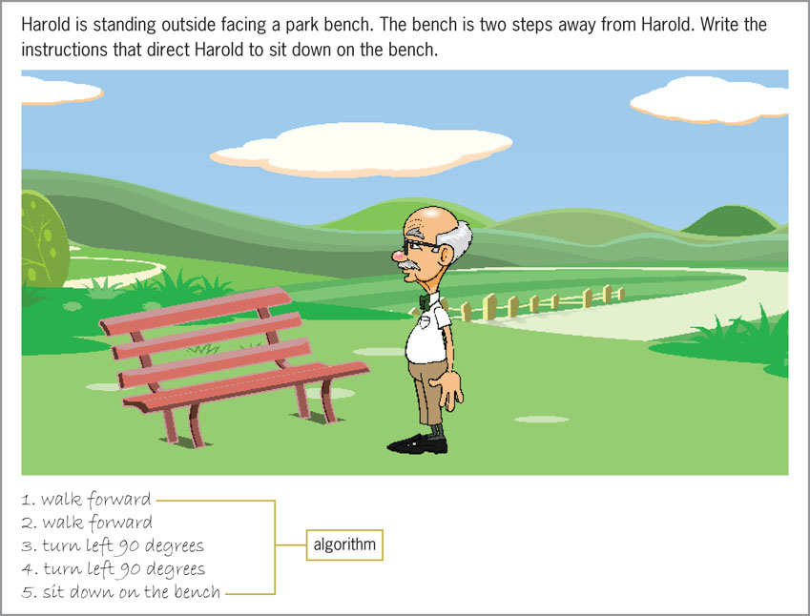
The Sequence Structure (cont.)
Figure 1-1 An example of the sequence structure
An Introduction to Programming with C++, Seventh Edition

Slide 16
The Selection Structure
The selection structure directs the computer to make a decision (evaluate a condition), and then take an appropriate action based upon that decision
The selection structure allows the programmer to evaluate data, therefore properly controlling the logic flow of the program
Another name for the selection structure is the decision structure
Example: stopping or going at a signal light
An Introduction to Programming with C++, Seventh Edition

Slide 17
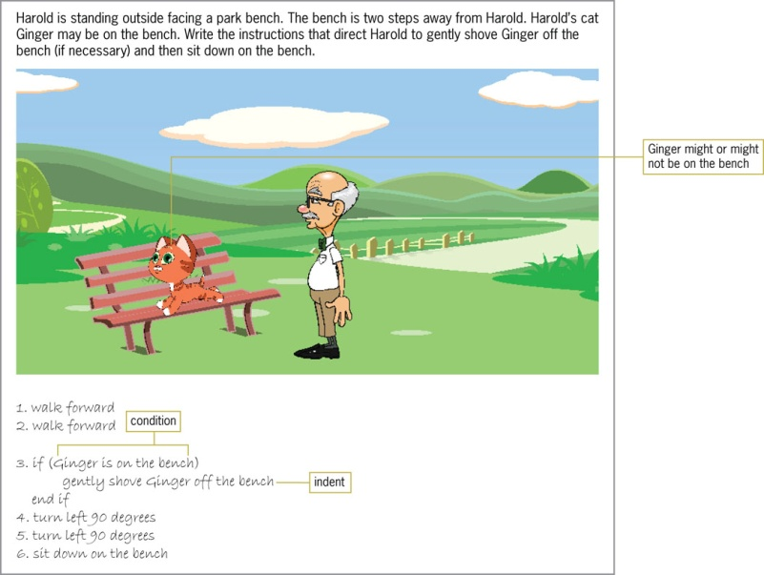
The Selection Structure (cont.)
Figure 1-2 An example of the selection structure
An Introduction to Programming with C++, Seventh Edition

Slide 18
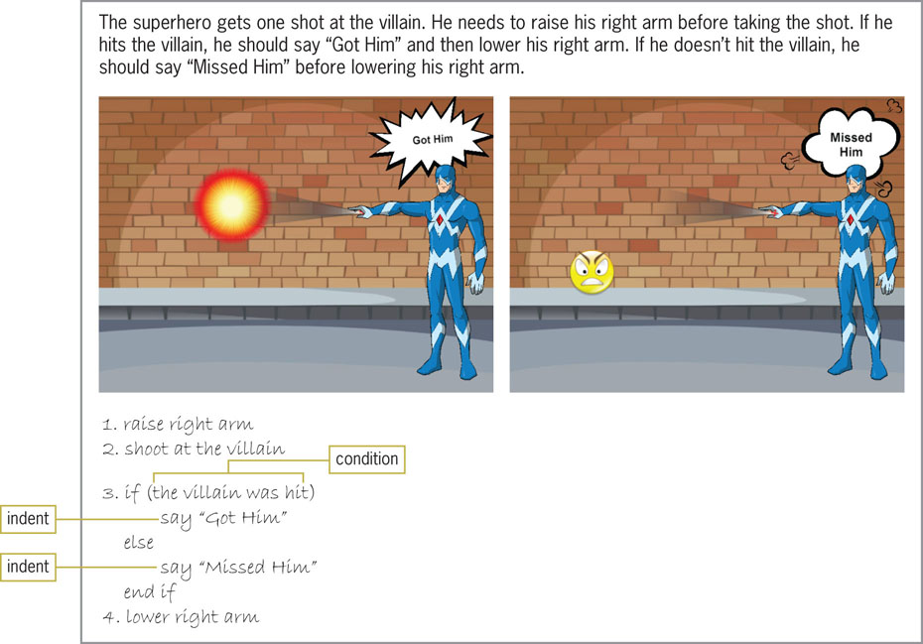
The Selection Structure (cont.)
Figure 1-3 Another example of the selection structure
An Introduction to Programming with C++, Seventh Edition

Slide 19
The Repetition Structure
The repetition structure, commonly called iteration or looping, directs the computer to repeat one or more program instructions until some condition is met
This condition may be checked at the beginning or end of the set of instructions to be processed dependent upon the language being used
The repetition structure allows the programmer to repeatedly process a set of instructions, while only typing them in once
An Introduction to Programming with C++, Seventh Edition

Slide 20
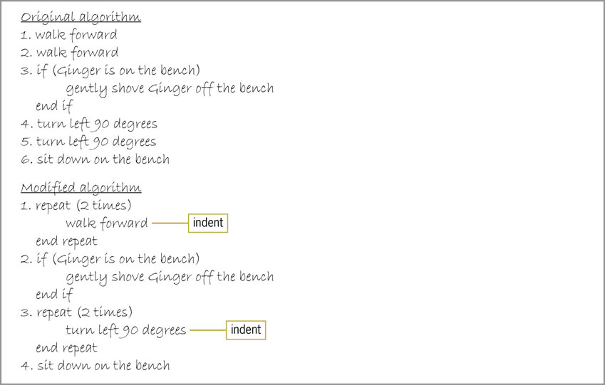
The Repetition Structure (cont.)
Figure 1-4 Original algorithm and modified
algorithm showing the repetition structure
An Introduction to Programming with C++, Seventh Edition

Slide 21
The Repetition Structure (cont.)
What could you do if you do not know precisely how many steps separate Harold from the boxes as described on the bottom of page 9?
An Introduction to Programming with C++, Seventh Edition

Slide 22
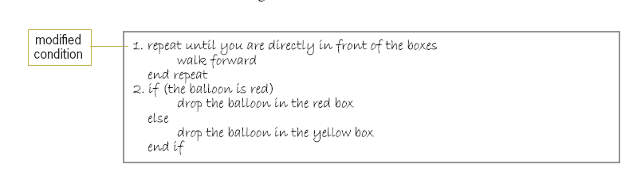
The Repetition Structure (cont.)
Figure 1-5 Algorithm showing the modified
condition in the repetition structure
An Introduction to Programming with C++, Seventh Edition

Slide 23
Summary
Programs are step-by-step instructions that tell a computer how to perform a task
Programmers use programming languages to communicate with the computer
First programming languages were machine language using 0s and 1s
Assembly languages followed, using mnemonics
High-level languages can be used to created procedure-oriented or object-oriented programs
An Introduction to Programming with C++, Seventh Edition

Slide 24
Summary (cont.)
An algorithm is a finite number of step-by-step instructions that accomplish a task
Algorithms utilize three basic control structures: sequence, selection, and repetition
The sequence structure directs the computer to process the program instructions, one after another, in the order in which they are listed
The selection structure directs the computer to make a decision (evaluate a condition), and then take an appropriate action based upon that decision
An Introduction to Programming with C++, Seventh Edition

Slide 25
Summary (cont.)
The repetition structure, commonly called iteration or looping, directs the computer to repeat one or more program instructions until some condition is met
The sequence structure is used in all programs
Most programs also contain both the selection and repetition structures
An Introduction to Programming with C++, Seventh Edition

Slide 26
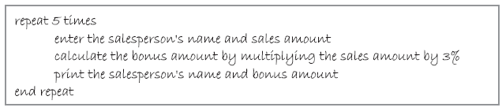
Lab 1-1: Stop and Analyze
A local business employs five salespeople and pays a 3% bonus on a salesperson’s sales
Your task is to create a program that calculates the amount of each salesperson’s bonus
The program should print each salesperson’s name and bonus amount
An Introduction to Programming with C++, Seventh Edition

Slide 27
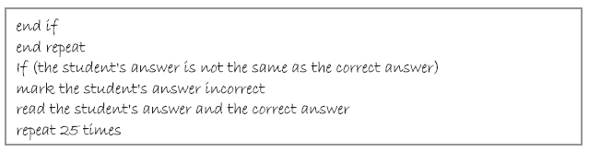
Lab 1-2: Plan and Create
Using only the instructions shown below, create an algorithm that shows the steps an instructor takes when grading a test that contains 25 questions
An Introduction to Programming with C++, Seventh Edition

Slide 28
Lab 1-3: Modify
Modify the algorithm shown in Lab 1-1 so that it gives a 3.5% bonus to salespeople selling more than $2,000
All other salespeople should receive a 3% bonus
An Introduction to Programming with C++, Seventh Edition

